Slide 1
Requesting Courses

Slide 2
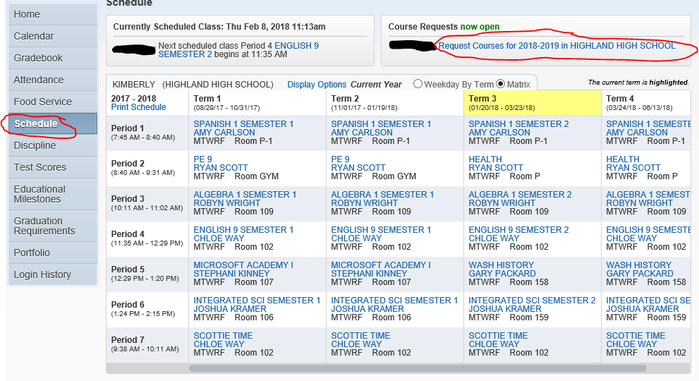
Directions:
Log Into Student Access
Click on “Schedule”
Click on “Request Courses for 2020-2021 in HIGHLAND HIGH SCHOOL”

Slide 3
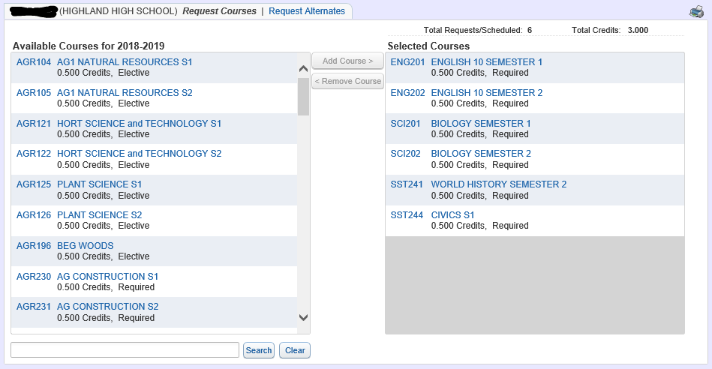
Your required courses have been preloaded here
You must select 6.0 total credits of classes
This is the list of Available Courses – Click on one and select “Add Course” to move it over to your “Selected Courses”

Slide 4
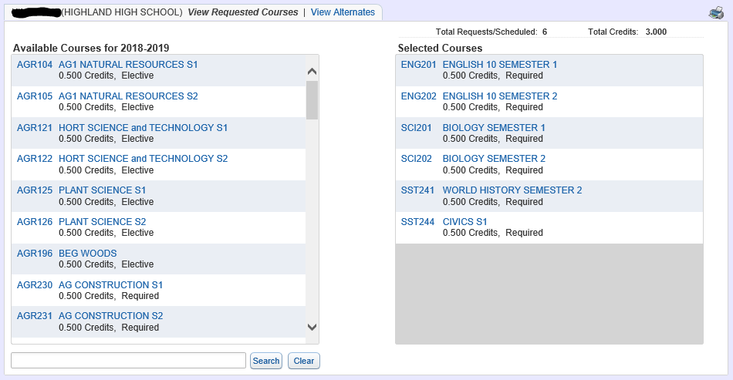
Once you have 6.0 Total Credits – Print your Course Requests – Place in Portfolio

Slide 5
Selecting Alternate Classes:
Click “View Alternates”

Slide 6
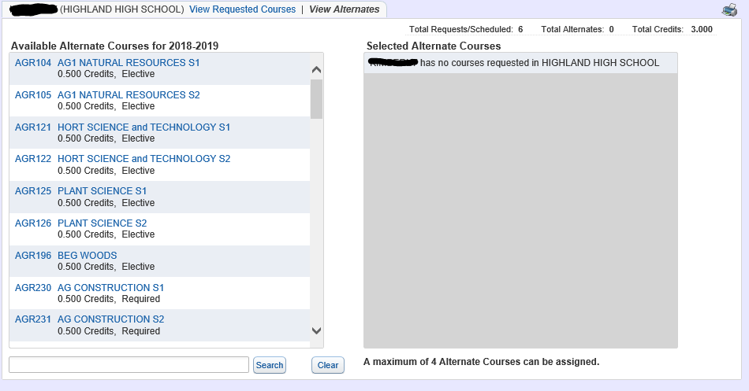
You must select a total of 4 Alternates – and they must be different than your requested courses!
Complete the same process of selecting courses on the left and moving them to the right-hand column

Slide 7
Turn in your paper Registration Worksheet to your Advisor

